Slide 1
IT306
Lecture 2
Files, IO, and Exception Handling in Files
Searching and Sorting Algorithms

Slide 2
Outline
File IO operations and Exception Handling
Searching Algorithms
Linear Search
Binary Search
Sorting Algorithm
Insertion, Selection, Bubble, Heap, Quick, Bucket, Radix sort

Slide 3
Read from a Text File
import java.io.*; import java.util.*;
FileReader
For text files using the system’s default encoding
Wrapped with BufferedReader to read chunks of characters
FileInputStream
For binary and text files that contain weird characters; it is byte oriented.
Can be combined with Scanner to support token-based processing of Strings in a line.
Notes:
Scanner over the inputstream helps to read strings. This class does not work very well with binary files.
FileIputStream makes a connection to an actual file.
You need to wrap a BufferedReader around a FileReader because FileReader provides an inefficient way of reading characters. It reads one character at a time, however, BufferedReader can provide efficient way of reading chunks of characters instead of reading one character at a time.

Slide 4
Read from a Text file using BufferedReader
Student[] students = new Student[100];
String path = "./src/FileIO/data.txt";
String outPath= "./src/FileIO/out.txt";
Scanner scan = null;
int counter=0;
BufferedReader br= null;
try{
br = new BufferedReader(new FileReader(new File(path)));
String line=null;
while ((line = br.readLine())!=null){
Student s = getStudent(line);
if(counter<100){
students[counter++] = s;
}}

Slide 5
Read from a Text file using Scanner
public static void main(String[] args) {
Student[] students = new Student[100];
String path = "./src/FileIO/data.txt";
String outPath= "./src/FileIO/out.txt";
Scanner scan = null; int counter=0;
try{
scan = new Scanner(new FileInputStream(new File(path)));
while(scan.hasNext()){
Student s = new Student (scan.next());
if(counter<100){
students[counter++] = s;
}}
scan.close();
Notes:
Suppose we have a textfile which contains student names

Slide 6
Write to Text Files
import java.io.*; import java.util.*;
FileWriter
For text files using the system’s default encoding
Wrapped with BufferedWriter to write chunks of characters
FileOutputStream
For binary and text files that contain weird characters; it is byte oriented
Can be combined with PrintWriter ; it is String oriented.
Notes:
BufferedWriter provides efficient writings of single characters , strings and arrays.

Slide 7
Writing to a Text file using BufferedWriter
FileWriter fw = new FileWriter(new File(path));
BufferedWriter bw = new BufferedWriter(fw);
bw.write("String of characters");
bw.append(‘C’);
bw.append(<character sequence>);
bw.close();

Slide 8
Writing to a Text File using
FileOutputStream fis =new FileOutputStream(outPath);
PrintWriter pw = new PrintWriter(fis);
for(int i=0; i<students.length; i++){
if(students[i]!=null)
pw.write(students[i].toString() +"\n");
}
pw.close();

Slide 9
Exception Handling in Files
FileNotFoundException
IOException
Exception Hierarchy
java.lang.Object
java.lang.Throwable
java.lang.Exception
java.io.IOException
java.io.FileNotFoundException

Slide 10
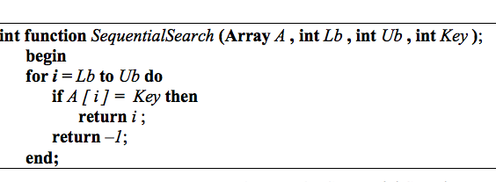
Searching algorithms
Linear search (sequential search)
Complexity: O(n)
array
0
1
…

Slide 11
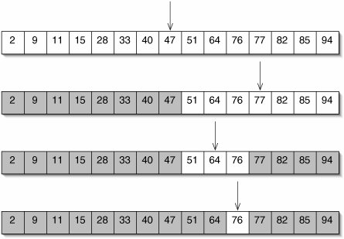
Searching algorithms
Binary search (ordered list)
76?
Found!

Slide 12
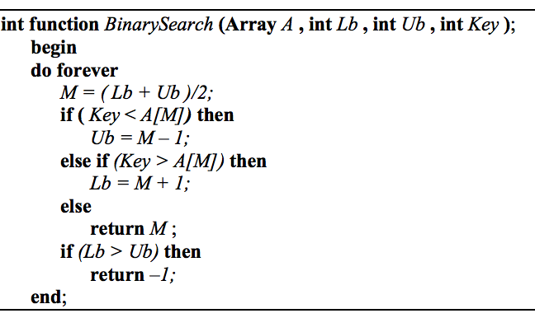
Searching algorithms
Binary search
Complexity: O(log n)

Slide 13
Binary Search (non-Recursive)
public static int nonRecursiveBinarySearch(int[] sortedArray , int q){
int start= 0 ;
int end = sortedArray.length;
while(start < end){
int mid = (start + end )/2;
if(q == sortedArray[mid])
return mid;
else if(q < sortedArray[mid]) end = mid;
else start = mid+1;
} //end while loop
return -1;
}

Slide 14
Sorting Algorithms
Insertion sort
Selection sort
Bubble sort
Heap sort
Bucket sort
Radix sort
Merge Sort
Quick Sort

Slide 15
Insertion sort (in-place)
10
Insert 10
Insert 8
Insert 7
Insert 11
Insert 1
10
8
8
10
7
10
10
8
7
8
8
10
7
8
11
10
7
8
11
1
8
1
11
10
10
7
7
8
10
11
10
11
1
7
1
11
8
7
7
10
8
1
Notes:
Placing the element in the correct order relative to those before it
Start with the first element in the array
When considering the next element in the array, if it is smaller than the first, we swap them.
For the third element, we have to swap it leftwards until it is in its proper place.

Slide 16
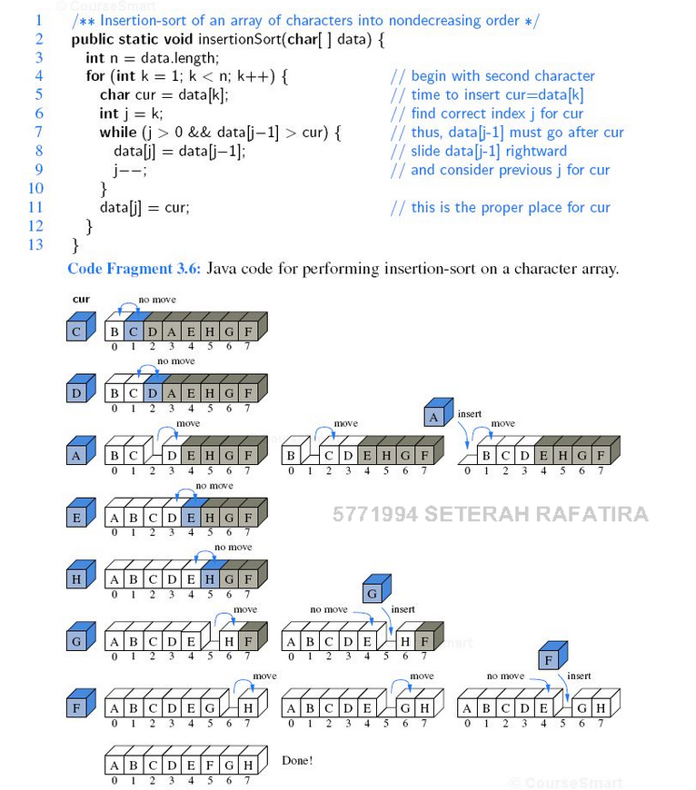

Slide 17
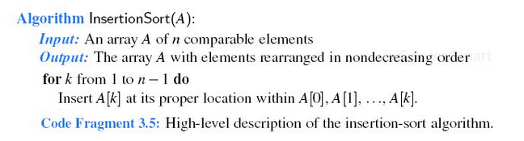
Insertion sort
Notes:
In insertion sort, the sorting process occur from left to right.

Slide 18
Insertion Sort
public static int[] insertionSort(int[] data){
for(int i =1; i< data.length; i++){
int k = i;
while(k > 0 && data[k] < data[k-1] ){
int temp = data[k-1];
data[k-1] = data[k];
data[k] = temp;
k--;
}
}
return data;
}

Slide 19
public int[] insertionSort (int[] data){
System.out.println("Printing the steps:");
for(int k=1; k<data.length; k++){
for(int i=k; i>0; i--){
if(data[i] < data [i-1]){ //swap
int temp = data[i-1];
data[i-1] = data[i];
data[i] = temp;
}
print(data); //printing the updated array
System.out.println();
}
}
return data;
}
Notes:
Avoiding index out of bound exception

Slide 20
Selection Sort (in place)
Ascending:
64 25 12 22 11 // this is the initial, starting state of the array
11 25 12 22 64 // sorted sublist = {11}
11 12 25 22 64 // sorted sublist = {11, 12}
11 12 22 25 64 // sorted sublist = {11, 12, 22}
11 12 22 25 64 // sorted sublist = {11, 12, 22, 25}
11 12 22 25 64 // sorted sublist = {11, 12, 22, 25, 64}
Video Tutorial
Sort Descending?
Notes:
The algorithm divides the input list into two parts: the sublist of items already sorted, which is built up from left to right at the front (left) of the list, and the sublist of items remaining to be sorted that occupy the rest of the list. Initially, the sorted sublist is empty and the unsorted sublist is the entire input list. The algorithm proceeds by finding the smallest (or largest, depending on sorting order) element in the unsorted sublist, exchanging it with the leftmost unsorted element (putting it in sorted order), and moving the sublist boundaries one element to the right.

Slide 21
Selection Sort
public static int[] selectionSort(int[] data){
int min=0, k=0;
for(int i=0; i<data.length-1; i++){
min = data[i];
for(int j=i+1; j<data.length; j++){
if(min > data[j]) {
min = data[j];
k=j; }}
if(data[i] > min){ //swap
int temp = data[i];
data[i] = data[k];
data[k] = temp;
} }
return data; }

Slide 22
public int[] selectionSort(int[] data){
//we have a sorted list and an unsorted list.
//’i’ indicates the LB for the unsorted list.
for(int i=0; i<data.length-1 ; i++){
int min_ix = i;
for(int j=i+1; j<data.length; j++){
if(data[j] < data[min_ix]){
min_ix = j;
}
}
if(i!= min_ix) {
//swap data[i] and data[min_ix]
int temp = data[i];
data[i] = data[min_ix];
data[min_ix] = temp;
}
System.out.println("printing the updated list");
print(data);
System.out.println();
}
return data;
}

Slide 23
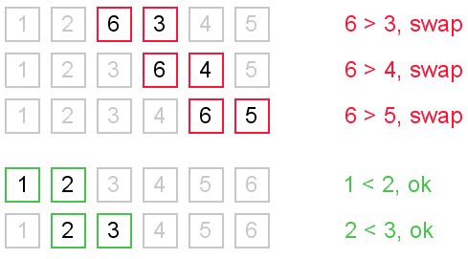
Bubble sort (in place)

Slide 24
Bubble sort
for(int x=0; x<n; x++) {
for(int y=0; y<n-1; y++) {
if(array[y]>array[y+1]){
int temp = array[y+1];
array[y+1] = array[y];
array[y] = temp;
}
}
}
Complexity?

Slide 25
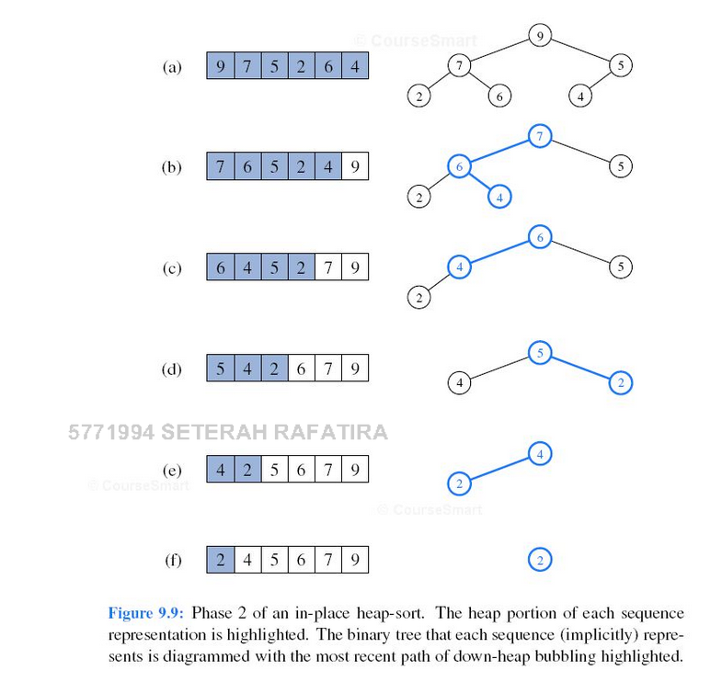
Heap sort
Binary heap: the parent is at least as large as the children
Heap-portion (highlighted) and sequence portion.
Delete the root at every iteration from the heap, and insert it as the previous element in the sequence.
Deleting the root requires rearranging the heap. The last node (BFS) replaces the root, then the tree is rearranged.
We will discuss this in more details in the incoming lectures.

Slide 26
Bucket sort
Indexing via keys
A bit of similarity to quick sort
Fast , on average runs on linear time.
Problem: we need a lot of buckets
The number of buckets is proportional to the key size in the worst case.
Multiple keys in a bucket: you have to sort inside the bucket in some way (expensive to add to a bucket)

Slide 27
Bucket sort cont.
Bucket sort works as follows:
Set up an array of initially empty "buckets".
Scatter: Go over the original array, putting each object in its bucket. Sort each non-empty bucket.
Gather: Visit the buckets in order and put all elements back into the original array.
Is Bucket sort considered “in-place”? NO.

Slide 28
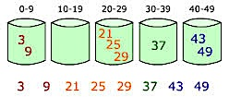
Bucket sort (Bin sort)
Implement buckets as queues.
Notes:
Drawback:
we must know the maximum value of any element that can be found in the unsorted array. This helps in initializing the required number of buckets.
We must be able to create enough buckets in memory for every element that we might possible encounter in the unsorted array. So there is a trade-off between time and space complexity here.
Bucket sort, or bin sort, is a sorting algorithm that works by partitioning an array into a number of buckets. Each bucket is then sorted individually, either using a different sorting algorithm, or by recursively applying the bucket sorting algorithm. It is a distribution sort, and is a cousin of radix sort in the most to least significant digit flavour.

Slide 29
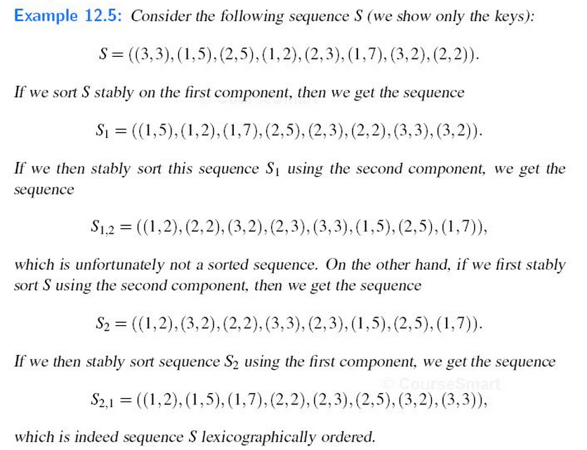
Stably Sort
Notes:
So we should sort the second component first.
We can guarantee that if two components are equal in the second sort, then their relative order in the starting sequence is preserved.

Slide 30
Radix sort
Start with the least significant digit. Perform a stable sort (see below) based on that key.
Repeat the process sequentially with each more significant digit.
Example: 849, 770, 67, 347, 201, 618, 66, 495, 13, 45
Round 1: 770, 201, 13, 495, 45, 66, 67, 347, 618, 849
Round 2: 201, 13, 618, 45, 347, 849, 66, 67, 770, 495
Round 3: 013, 045, 066, 067, 201, 347, 495, 618, 770, 849
You can use Bucket sort to implement Radix sort. Each bucket has an index in the range [0,9].
Notes:
we have ignored the precise sorting mechanism employed at step two in each iteration of the algorithm. That's because radix sort gives us the freedom to choose whichever sorting algorithm we please, so long as it is a stable sorting algorithm. The runtime analysis will, of course, depend on the runtime of the sorting algorithm employed at step two of each iteration.
Using Bucket sort for stable sort , with this ➔ O(nk) where k is the max number of digits in one element and O(n) is the performance complexity of bucket sort.
We need 10 buckets for this example, because we want to group the numbers based on their least significant digit that varies from 0-9 as their code.
It is quite common, and therefore worth mentioning, to use bucket sort for our stable sorting algorithm
in radix sort. Because we are only sorting by one digit at a time, we only have to set up ten buckets,
[0..9], to accomplish this goal. However, the implementation of those buckets will necessarily vary
from the one given in the previous section of these notes, because each bucket must be able to hold
multiple values, which will not be equal to the index for that bucket. One common solution, then, is to
implement the buckets as queues.
Stably sort means sorting an entity based on its components in multiple steps. (an incremental approach).

